Slide 1
Capstone project(InstaSMart)
By
NAME : PRABHA T
ID : 2154384

Slide 2
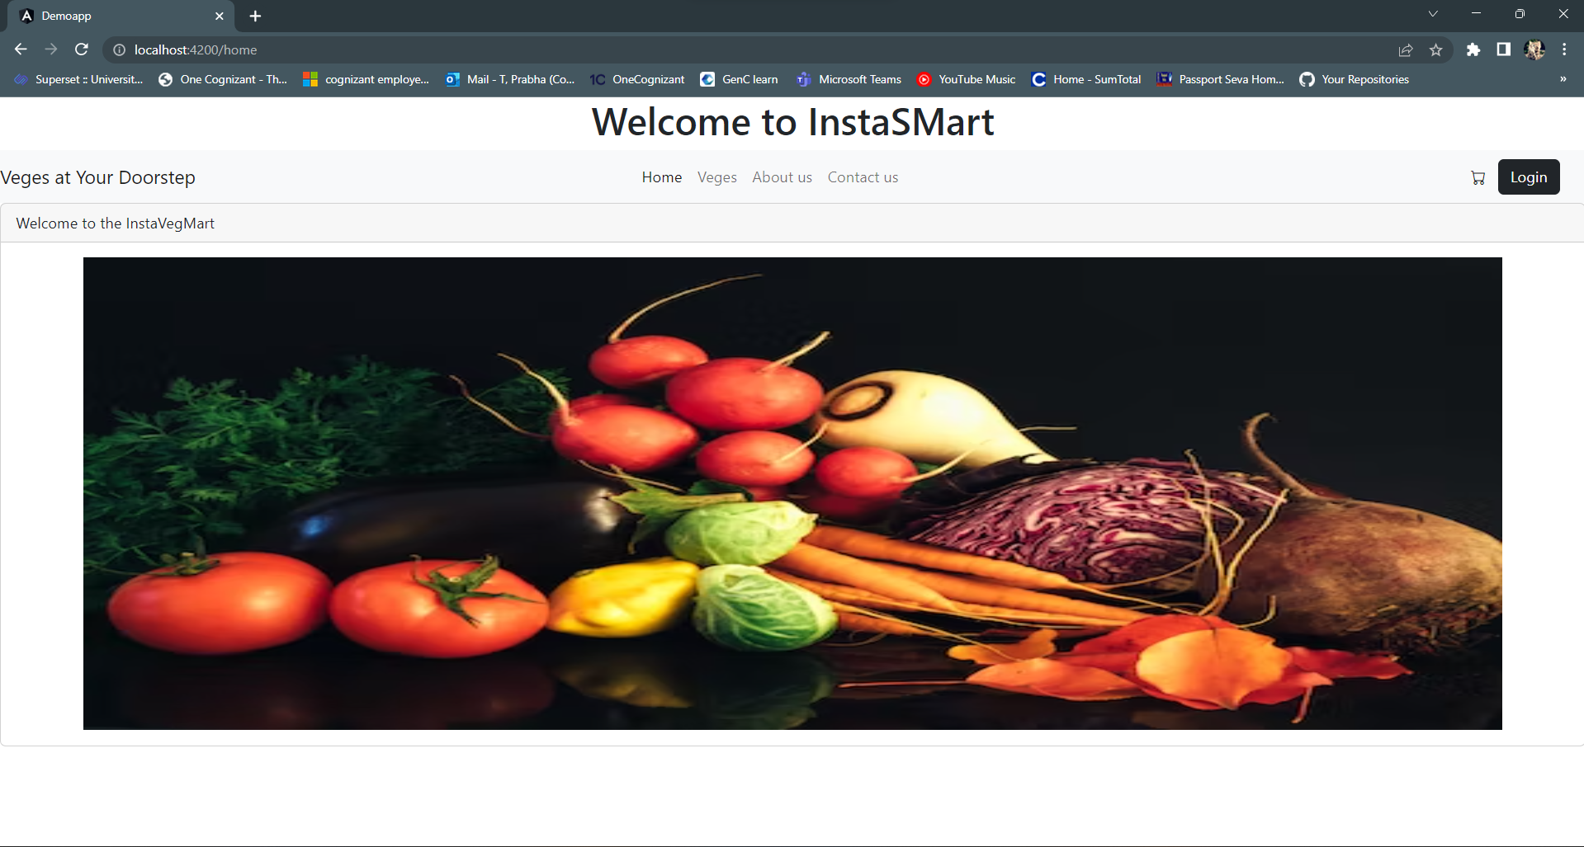
HOME PAGE

Slide 3
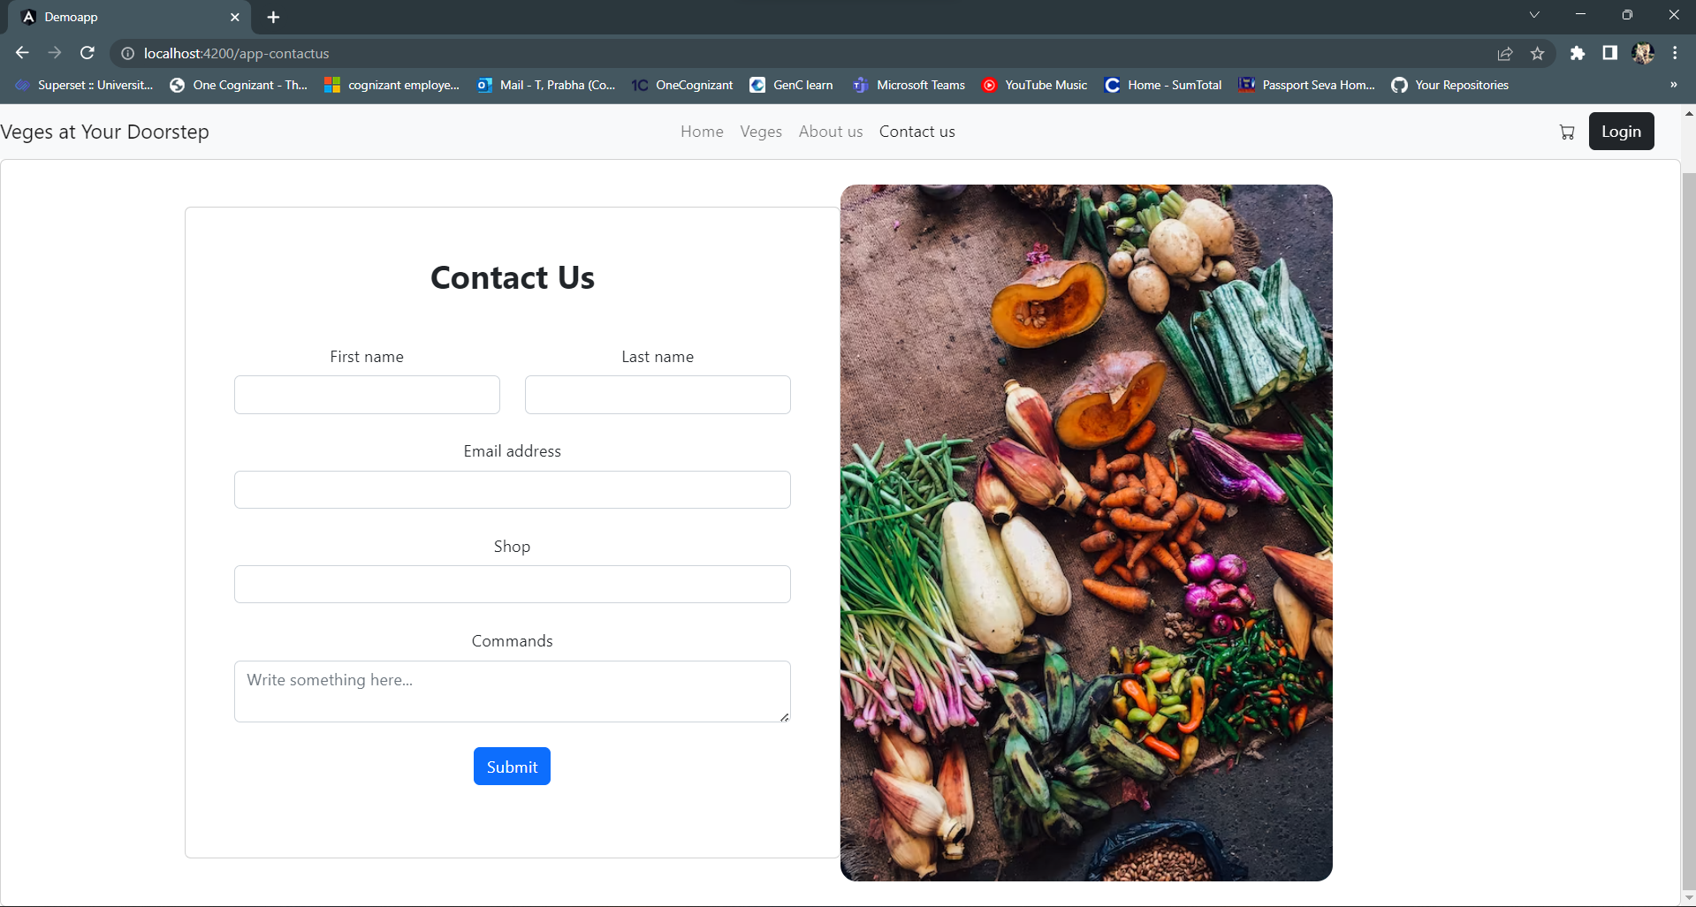
Contact us page

Slide 4
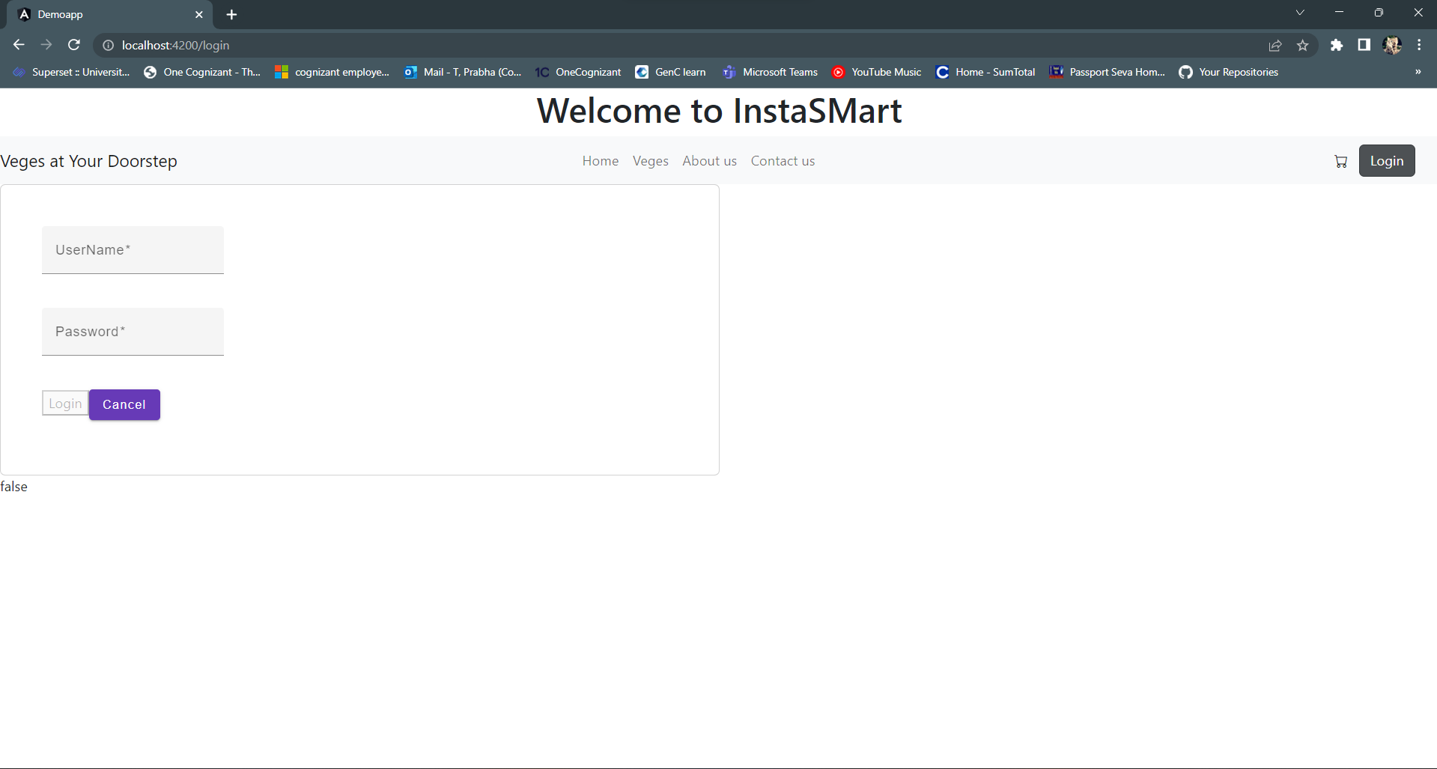
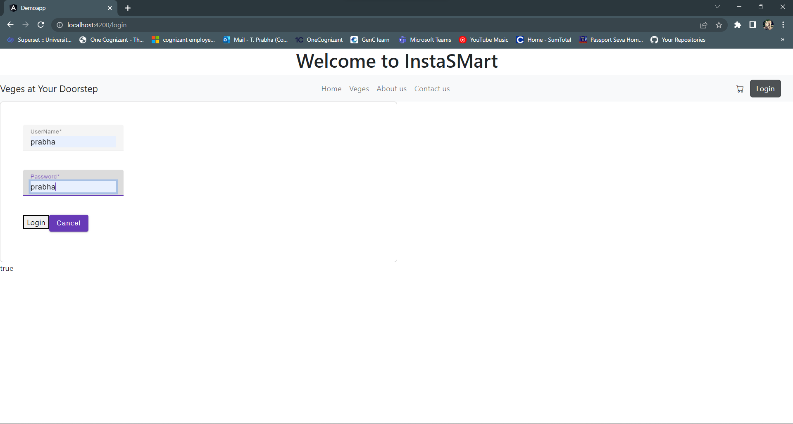
Login Page (when Logged In as a admin or user Veges card page will be rendered)

Slide 5
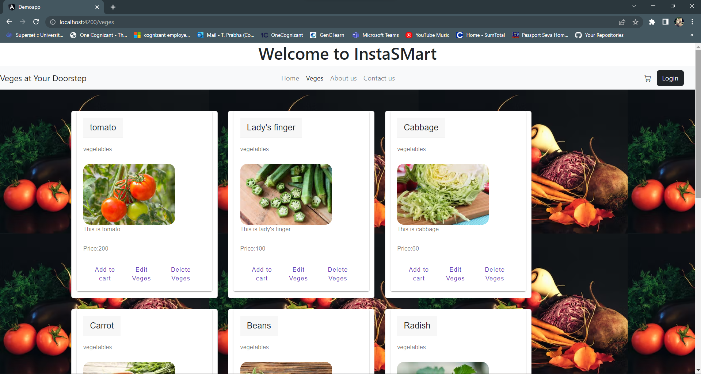
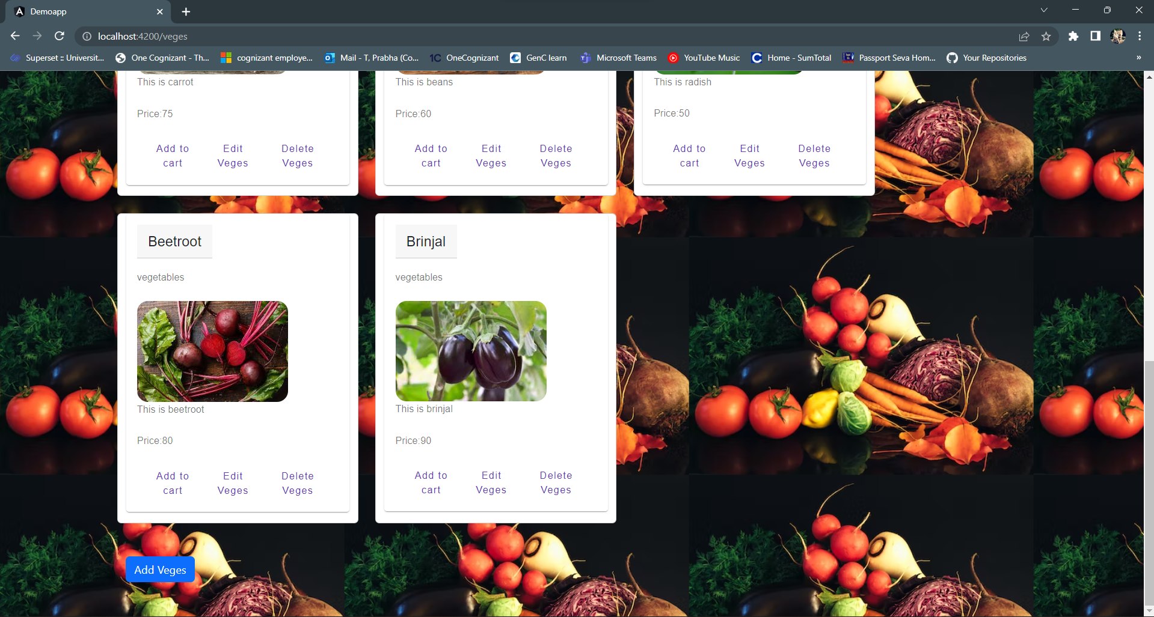
Veges page (Veges add, edit and delete can be performed by admin login only. User can only purchase by adding the veges to cart)

Slide 6
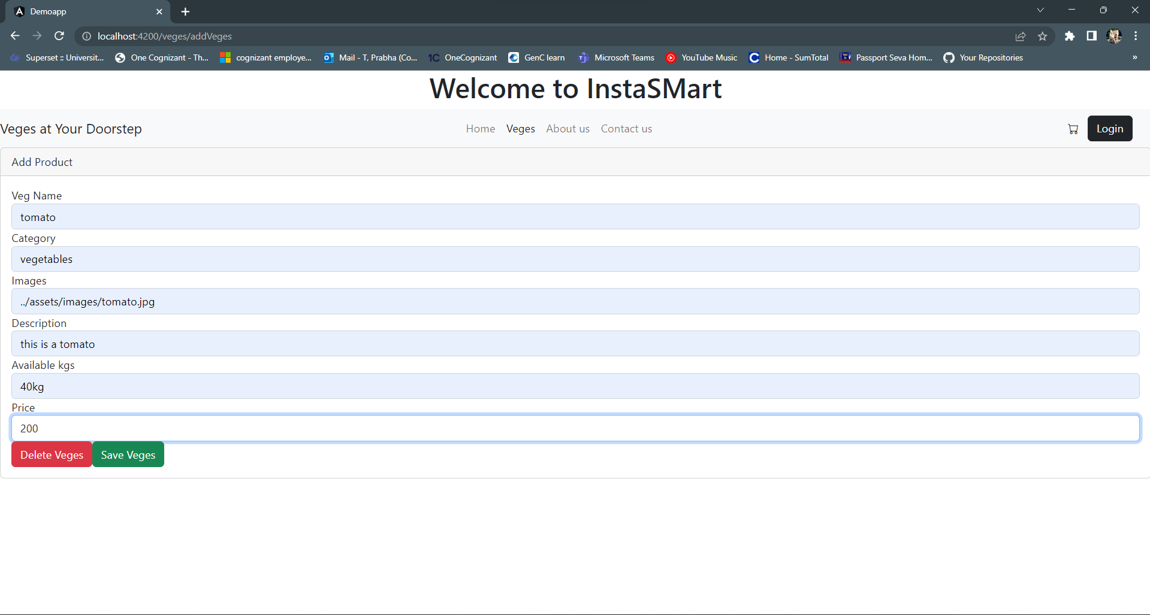
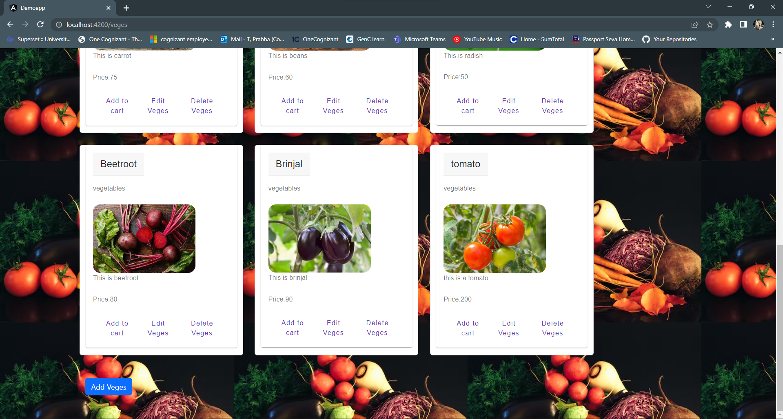
Add Veges (left side-by clicking on add veges, we are adding new veges to the card) (right side-New veges is added to the card)

Slide 7
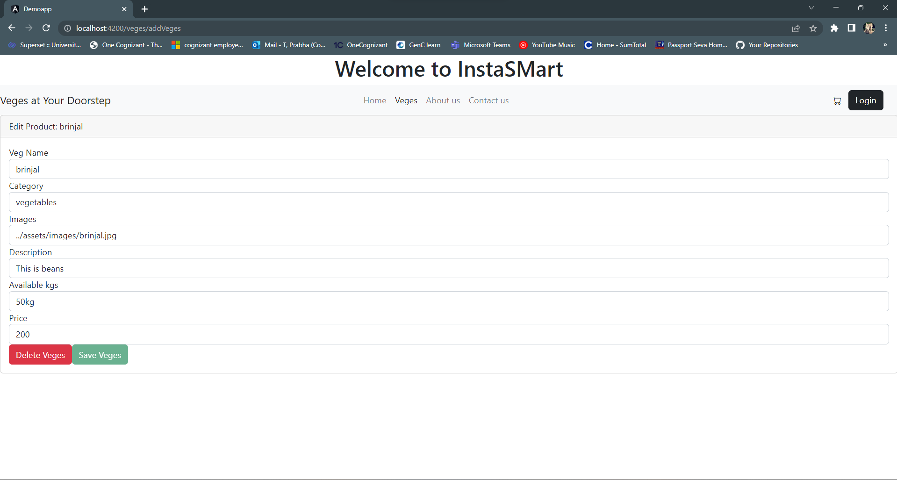
Edit Veges (we can able to edit the name, category, image, description and price of that particular veges)

Slide 8
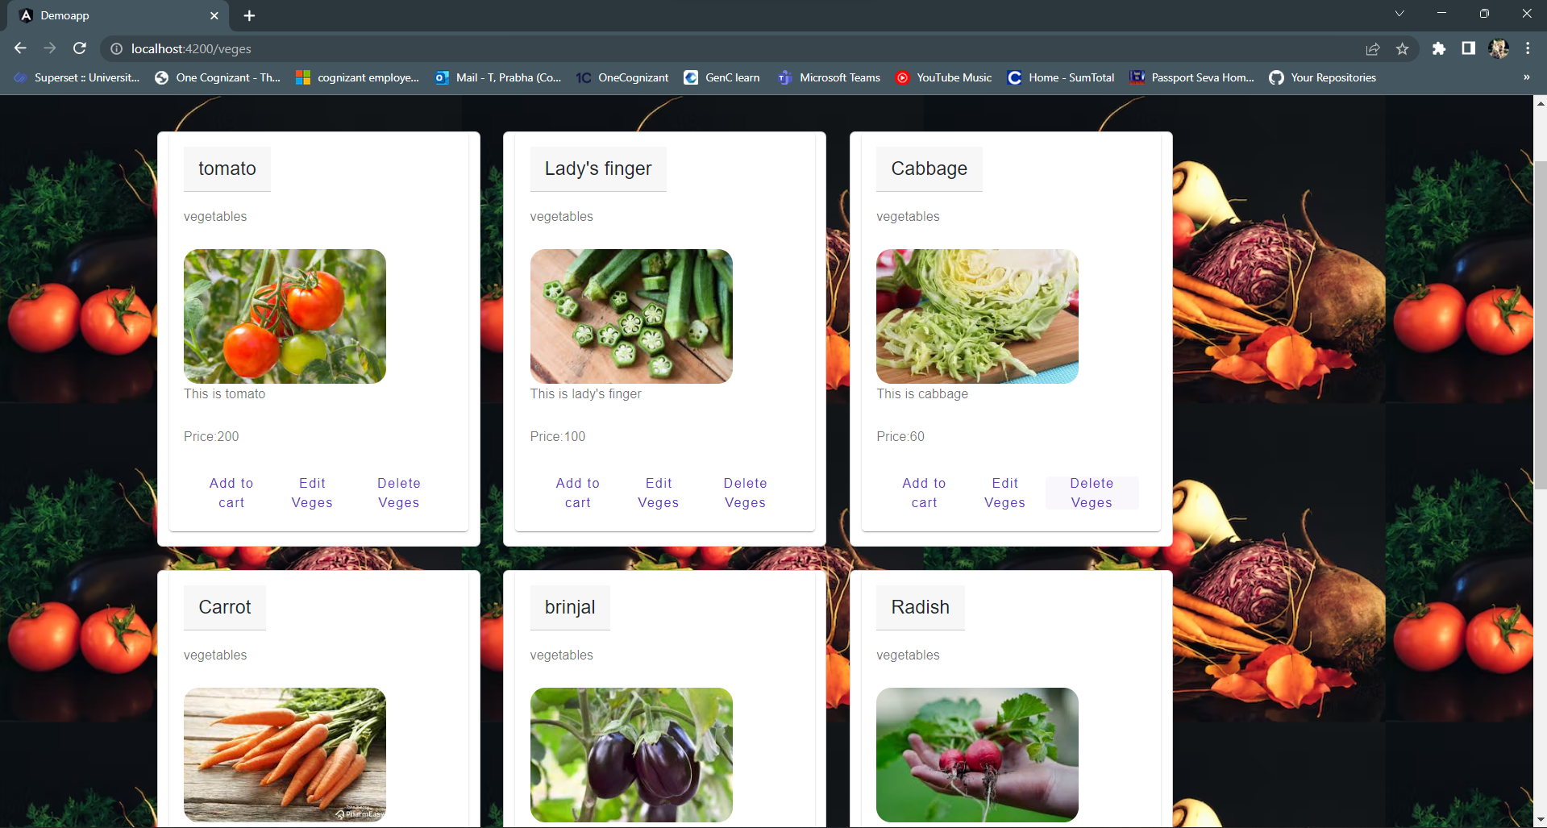
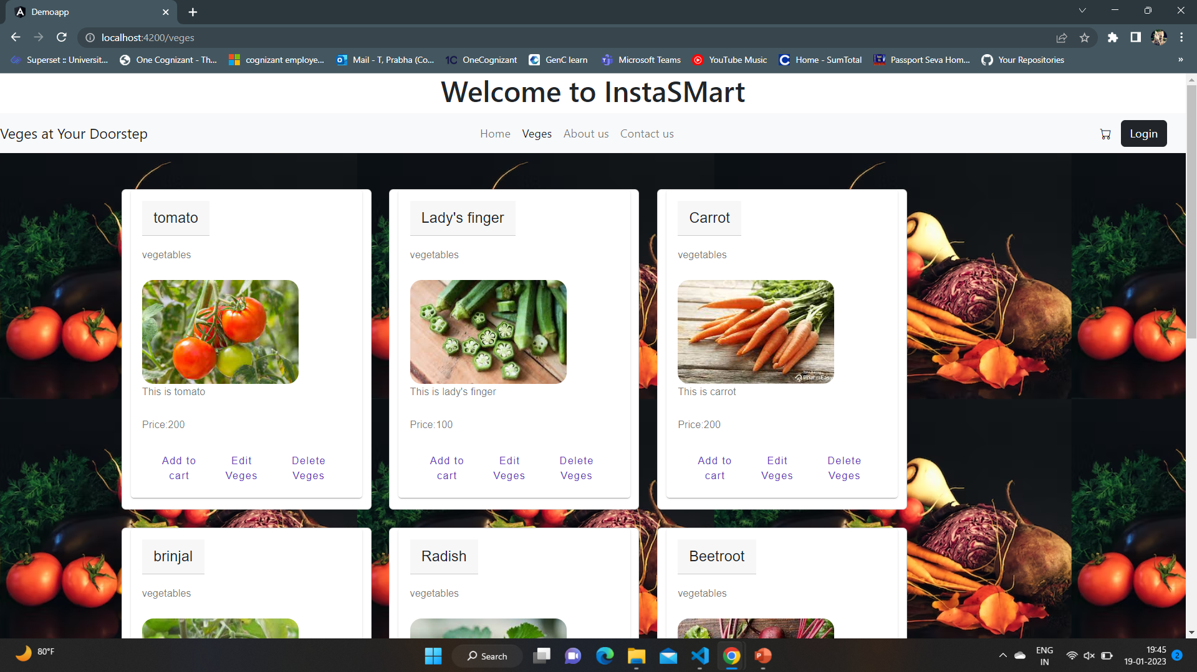
Delete veges (left side – cabbage card is available for the customer) (right side- cabbage card is deleted by delete veges)

Slide 9
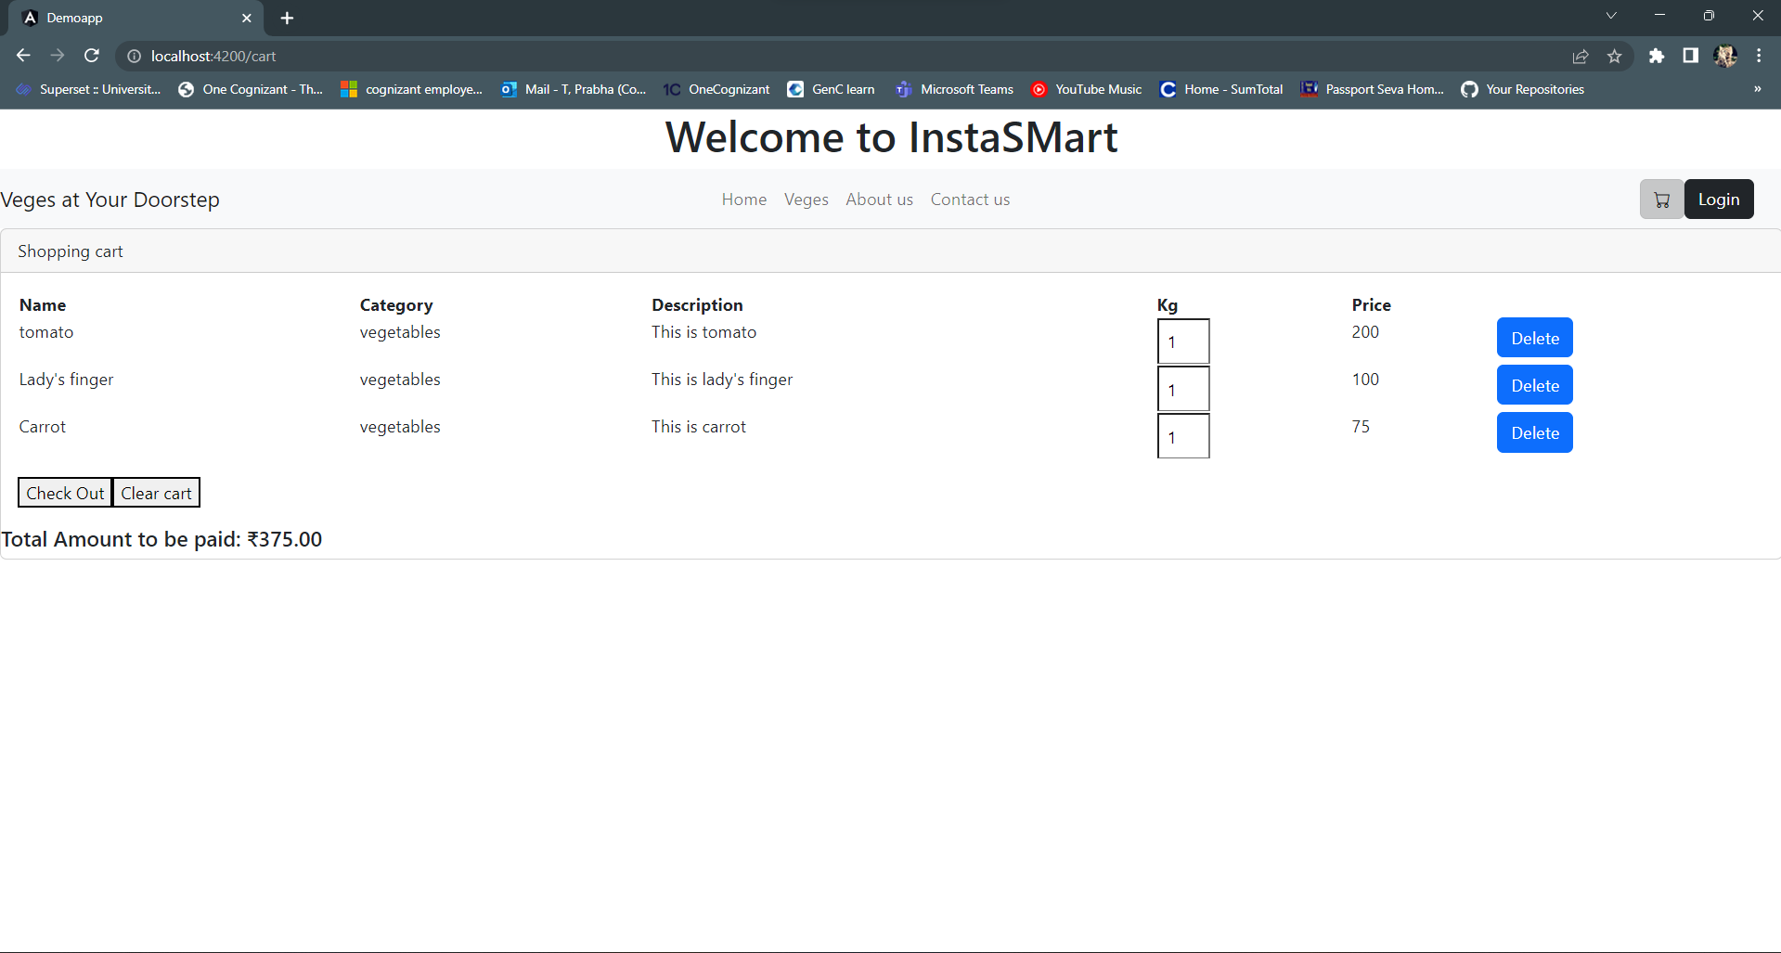
Cart page (Veges are added to the cart and total price is calculated and shown)

Slide 10
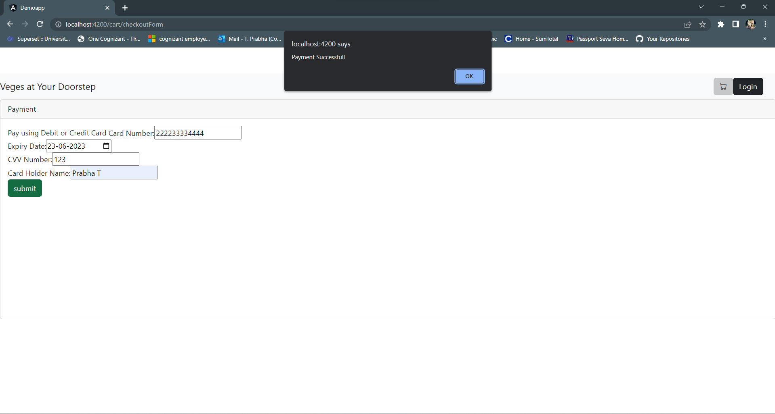
Checkout page (payment details are given and submitted, alert box pops as payment successful)

Slide 11
THANK YOU

